Slide 1
IoT Security Concerns
Engineering Secure Software

Slide 2
Agenda
What is IoT?
Security implications of IoT
IoT Attack Surface Areas
IoT Testing Guidelines
Top IoT Vulnerabilities

Slide 3
What is IoT?
IoT is a self-configuring and adaptive system consisting of networks of sensors and smart objects whose purpose is to interconnect “all” things, including everyday and industrial objects, in such a way as to make them intelligent, programmable, and more capable of interacting with humans.
“IEEE definition”
Notes:
The interface between the physical and digital world that allows one to gather information from —and control—everyday objects.

Slide 4
IoT Examples
Estimates: 50 billion connected devices by 2020
Refrigerator with the screen
The smart thermostat
The TV connected to the Internet
Smart cars
Mobile health
Smart grids

Slide 5

Security implications of IoT
http://techcrunch.com/2015/10/24/why-iot-security-is-so-critical/#.crwj3zc:exN4
Notes:
An example is the integration of Whirlpool’s new home washers and dryers into the Google’s Nest
Environment, enabling the dryers to coordinate their cycle on whether the Nest thermostat determines you are home
or not. So, now not only does Google know you are not home, but Whirlpool does as well. Bottom line, the cyber threat
surface just doubled (not to mention the potential wrinkle surface by not immediately drying wet clothes).

Slide 6
IoT Security Concerns
Privacy Concerns:
90 percent of devices collected personal information via the device, the cloud or the device’s mobile application.
many devices transmit this information across networks without encryption.
Insufficient Authentication/Authorization:
80 percent failed to require passwords of sufficient complexity and length.
A huge number of users and devices rely on weak passwords e.g. 1234, 123456

Slide 7
IoT Security Concerns (Cont.)
Transport Encryption:
70 percent of devices used unencrypted network services.
most devices surveyed failed to encrypt data, even when the devices were using the Internet
Web Interface:
60 percent raised security concerns with their user interfaces, e.g. persistent cross-site scripting, poor session management and weak default credentials.
Insecure Software:
60 percent did not use encryption when downloading software updates.

Slide 8
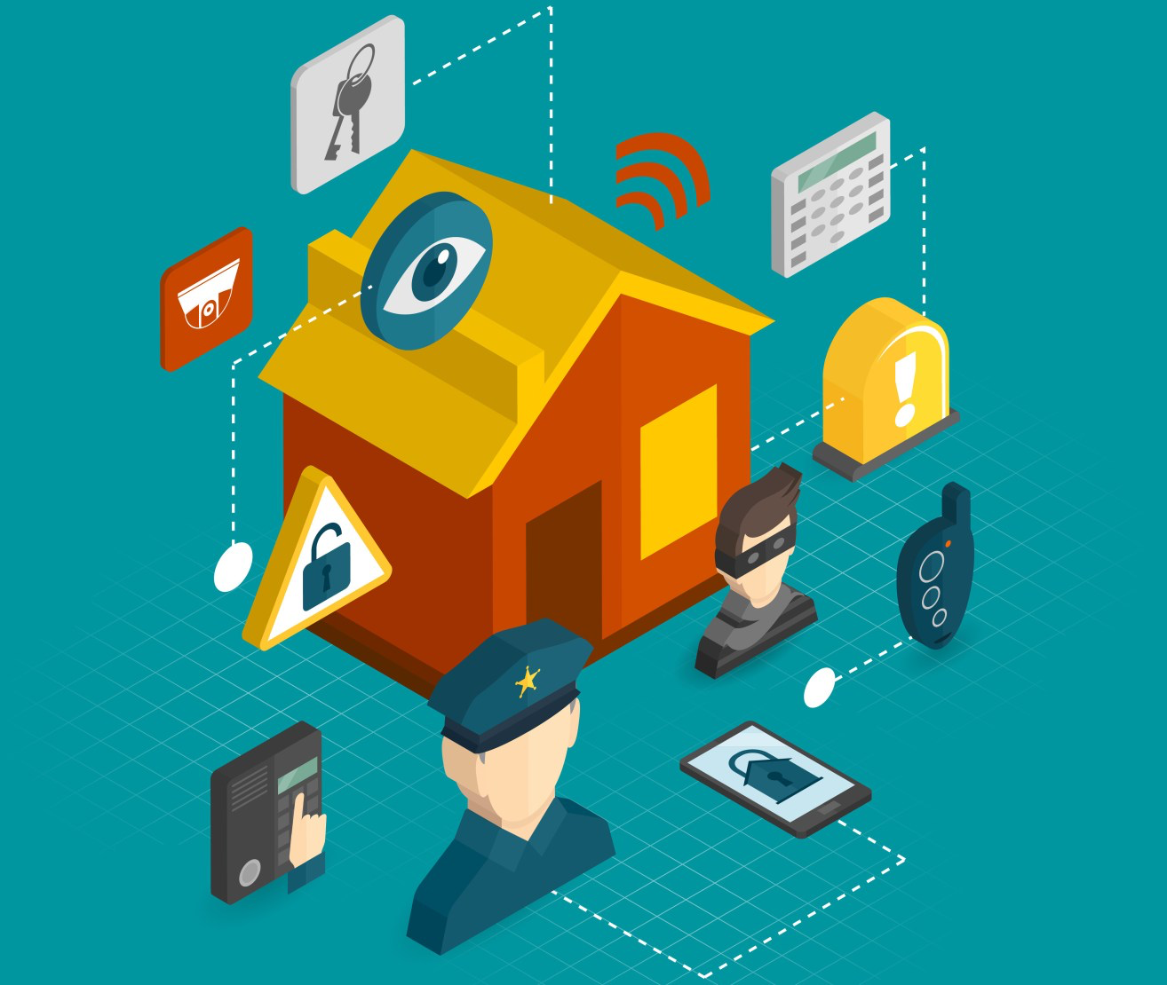
CIA of IoT
Confidentiality
IoT provider will most likely be able to sell the data
Integrity
Not an issue for a user’s home temp
How about a user’s credit score?
Availability
Vulnerable to DDOS attacks

Slide 9
What things can be done before products reach the market to make them and services inherently more secure?
Notes:
Open discussion

Slide 10
IoT Risks
Insecure web interface
Insufficient authentication/authorization
Insecure network services
Lack of transport encryption
Privacy concerns
Insecure cloud interface
Insecure mobile interface
Insufficient security configurability
Insecure software/firmware updates
Poor physical security
Notes:
By OWASP for 2014

Slide 11
IoT Attack Surface Areas
Ecosystem access control
Administrative interface
Ecosystem communication
Update mechanism
Network traffic
Cloud web interface
Third-party backend APIs
Notes:
What common surface areas do IoT systems share that I need to make sure I don’t miss?

Slide 12
IoT Attack Surface Areas (Cont.)
Device memory
Device firmware
Device physical interfaces
Device network services
Device web interface
Local data storage
Vendor backend APIs
Mobile application

Slide 13
IoT Vulnerabilities
Ecosystem Access Control
Implicit trust between components
Enrollment security
Decommissioning system
Lost access procedures
Ecosystem Communication
Health checks
Heartbeats
Ecosystem commands
Deprovisioning
Pushing updates
Device Web Interface, Administrative Interface, Cloud web interface
SQL injection
Cross-site scripting
Username enumeration
Weak passwords
Account lockout

Slide 14
IoT Vulnerabilities
Mobile Application
Implicitly trusted by device or cloud
Known credentials
Insecure data storage
Lack of transport encryption
Third-party Backend APIs
Unencrypted PII sent
Encrypted PII sent
Device information leaked
Location leaked
Vendor Backend APIs
Inherent trust of cloud or mobile application
Weak authentication
Weak access controls
Injection attacks

Slide 15
IoT Testing Guidelines
Insecure software/firmware
Includes update capability?
Encrypted update files?
Uses signed files? Validates files before installation?
Poor physical security
Does the device utilizes the minimum # of physical external ports?

Slide 16
IoT Testing Guidelines
Insecure Mobile interface
Multi-factor authentication
Transport encryption
Strong password, password expiration
Amount of personal info collected
Insecure web interface, cloud interface
XSS, SQLi, and CSRF
The account lockout mechanism
HTTPS
Are weak passwords allowed?

Slide 17
Privacy and Liability
Privacy concerns
Amount of personal info collected
Collected personal info are encrypted in transit?
Data are anonymized?
Liability
“old” user license agreements →digital devices
IOT devices perform physical action (e.g. turn on lights, unlock doors)

Slide 18
Final Notes
Manufacturers of IoT devices should be taking steps to secure them now before the problem becomes unmanageable.
Carry out a security review of all devices and components to detect vulnerabilities
Apply security standards that all devices need to live-up to before production
Make security a cornerstone of the production life-cycle

Slide 19
Activity
In groups of 4-5, prepare a report about an IoT vulnerability:
Describe the IoT vulnerability, its causes, consequences, and fixes if any.
What is the attack surface area that was targeted?
How do you think it could have been mitigated?

Slide 20

Happy End Of semester

Slide 21
References
https://www.owasp.org/index.php/OWASP_Internet_of_Things_Top_Ten_Project
http://www.cmswire.com/cms/internet-of-things/top-5-internet-of-things-security-concerns-026043.php
http://www.afcea.org/mission/intel/documents/InternetofThingsFINAL.pdf

